Slide 1
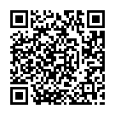
Online Survey: Assessing Patient Awareness and Satisfaction with Information on Potential Risks of Cancer-Related Venous Thromboembolism and Anticoagulation
A Global Initiative for World Thrombosis Day 2022
Scan QR code with mobile phone
https://redcap.link/cat-vte-wtd

