Slide 1
Laboratory testing for von Willebrand disease
Emmanuel J Favaloro, Haematology, ICPMR, Westmead Hospital
October, 2017
emmanuel.favaloro@health.nsw.gov.au

Slide 2
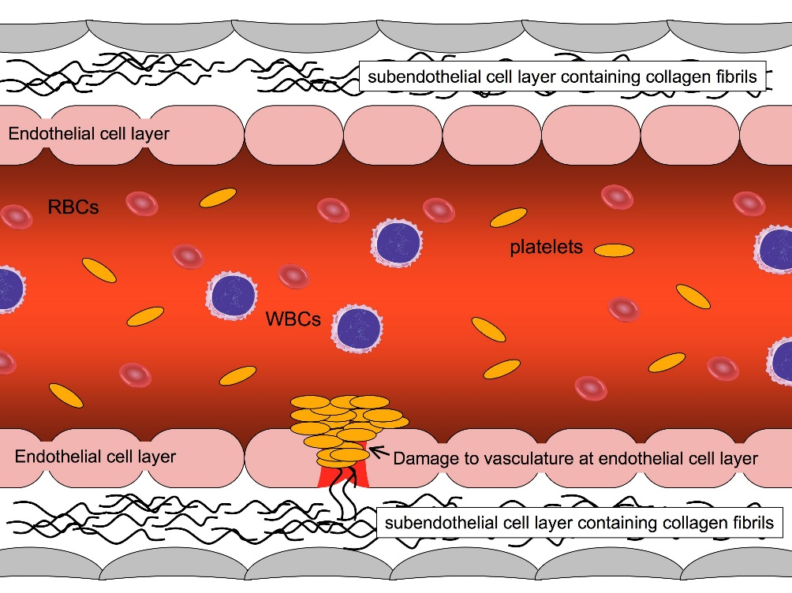
The Basics - von Willebrand factor (VWF)
Large and complex molecule
Plasma VWF – multimers of core protein (monomer of 2050 AA) ranging in size from 250kDa to >20000kDa
Has binding sites for many ligands – these describe various functions of VWF
The larger the size, the more ‘overall functionality’ or adhesiveness.
  ‘High molecular weight’ (HMW) multimers more adhesive than intermediate or low molecular weight multimers
Absent, deficient, or defective VWF = von Willebrand ‘disease’ (or ‘disorder’ [VWD]; congenital) or acquired von Willebrand ‘syndrome’ (aVWS)

Slide 3
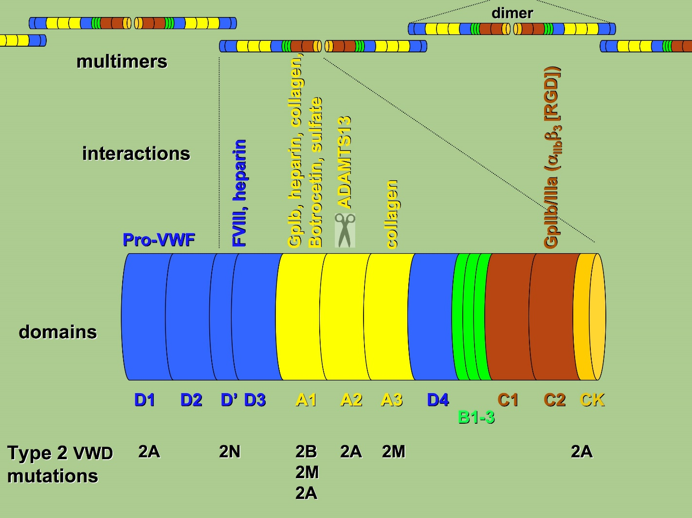
VWF structure & binding sites
VWF
Ligand
Laboratory Assay
D
FVIII
VWF:FVIIIB
D3
GPIbα
VWF:RCo / RIPA
GPIb binding assays
A1
A2
A3
Collagen
VWF:CB
D4
B₁₋₃
C1
C2
GPIIbIIIa
Modified: From Andreas Hillarp , in: Bolton-Maggs et al. Haemophilia. 2012; 18 (S4): 66-72.

Slide 4
The Basics - von Willebrand disease (VWD)
von Willebrand factor (VWF) disorders:
  Defect and/or deficiency in VWF
  congenital - von Willebrand disease (VWD)
  acquired - von Willebrand syndrome (AVWS)
VWD is the most common inherited bleeding disorder
  reported incidence up to 1% of the general population
  more realistic incidence (patients seeking support for bleeding related issues) ~0.1%-0.01%
  probably more common than haemophilia A (although severe HA probably more common than ‘severe VWD’)
AVWS incidence unknown, but may represent up to ~25% of patients presenting for VWD investigation

Slide 5
von Willebrand disease – testing/classification
  ‘Guidelines’ for VWF testing for VWD diagnosis – ISTH SSC VWD Classification (2006)
VWD separated into six types: 1, 2A, 2B, 2N, 2M, 3
Quantitative deficiencies (type 1 = partial; type 3 = total)
Qualitative defects (+/- quantitative deficiency)
  type 2A = loss of HMW VWF
  type 2B = hyper-adhesive VWF (loss of HMW VWF & mild thrombocytopenia)
  type 2N = loss of FVIII binding (loss of FVIII stability and loss of FVIII activity from plasma)
  type 2M = ‘the rest’ (dysfunctional VWF not associated with loss of HMW VWF)
Sadler et al. JTH. 2006; 4: 2103-14

Slide 6
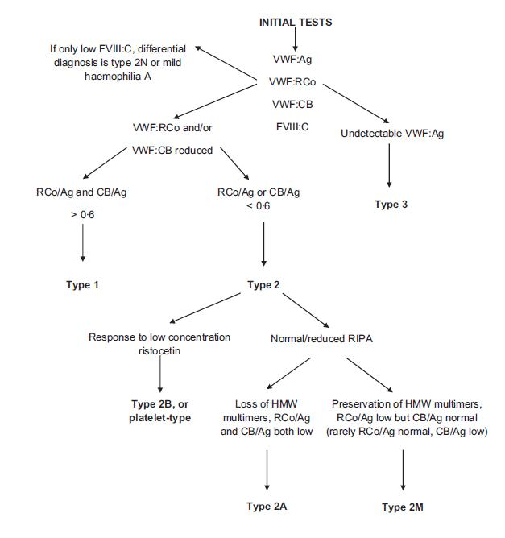
von Willebrand disease – diagnosis/management
  ‘Guidelines’ for VWF testing for VWD diagnosis – UKHCDO (2014)
Evidence based guideline from United Kingdom Haemophilia Centre Doctors Organization guideline approved by the British Committee for Standards in Haematology
Update of their 2004 guidelines
Laffan et al. The diagnosis and management of von Willebrand disease: a United Kingdom Haemophilia Centre Doctors Organization guideline approved by the British Committee for Standards in Haematology. Br J Haematol 2014; 167: 453–65.

Slide 7
VWD lab diagnosis – a summary
Type 1 – low VWF, but all VWF assays similar (i.e., ratios ~1 (>0.7)); VWF:Ag, VWF:CB, VWF:RCo.
Type 3 – ‘undetectable’ VWF (LOD issues); VWF <5U/dL (VWF:Ag [VWF:CB, VWF:RCo)]).
Type 2A – usually low VWF:Ag, but disproportionally lower VWF:CB & VWF:RCo (both activity/Ag ratios <0.7)
Type 2B – low dose RIPA; disproportionally lower VWF:CB & VWF:RCo than VWF:Ag (both activity/Ag ratios <0.7)
Type 2N – VWF:FVIIIB (FVIIIB/VWF:Ag <0.7) [low FVIII:C/VWF:Ag]
Type 2M – low VWF ‘activity’/Ag ratio

Slide 8
VWD investigation - most common test panel
Factor VIII (FVIII) activity
  one stage assay of ‘coagulant’ activity (FVIII:C) (usually automated analyzer);
  less commonly chromogenic assay (generally only in haemophilia centers).
VWF:Ag - measure level of VWF protein:
  typically by ELISA or LIA (turbimetric); usually automated analyzers.
  occasionally other techniques (fluorescence or chemiluminescence (VIDAS; AcuStar); flow cytometry described)
VWF Activity by VWF:RCo
    classically using platelets and an aggregometer (semi-automated)
    alternatively, using platelets on an automated analyzer
    alternate techniques now available (e.g., platelets & flow cytometry; latex with automated instruments [‘VWF:GPIbR’]; chemiluminescence [AcuStar])

Slide 9
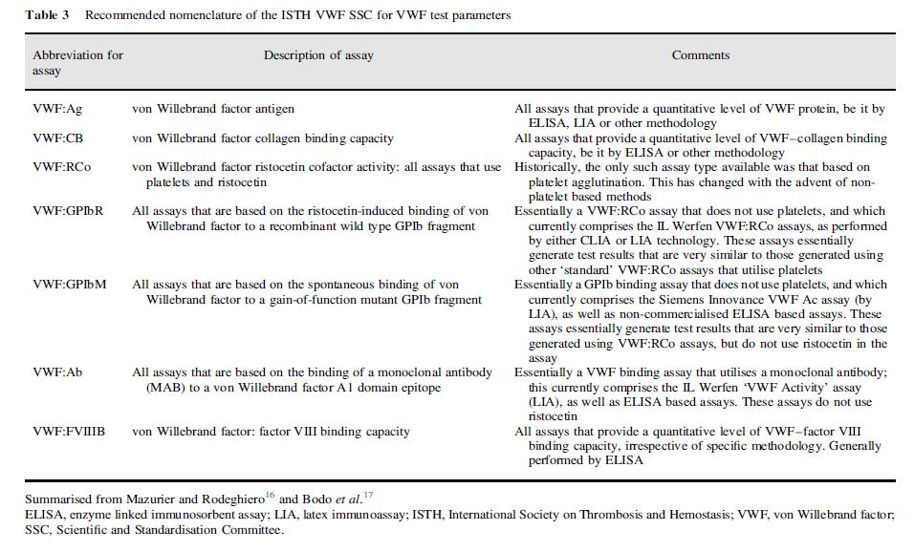
VWD investigation – new ISTH SSC nomenclature for ‘platelet related activity’ assays
Mazurier C, Rodeghiero F. Thromb Haemost 2001;86:712.
Bodo I, et al. J Thromb Haemost 2015;13:1345–50.
Favaloro et al. Pathology 2016;48:303-18.

Slide 10
VWF ‘activity assays’ – Australian trends
Updated from Favaloro & Mohammed. Thromb Res 2014. 134:1292–1300

Slide 11
Measurement of VWF protein level - ‘Antigen’ (VWF:Ag)
Extent of color reaction proportional to level of VWF
Color reaction
ELISA
Substrate
HRP
HRP
HRP
Labeled (Rabbit) α-VWF
VWF
Favaloro EJ, Mohammed S, Patzke J. Laboratory Testing for von Willebrand Factor Antigen (VWF:Ag). Methods Mol Biol. 2017;1646:403-416.
(Rabbit) α-VWF

Slide 12
Measurement of VWF protein level - ‘Antigen’ (VWF:Ag)
LIA
Latex aggregation proportional to level of VWF
α-VWF
VWF
Latex particles
Favaloro EJ, Mohammed S, Patzke J. Laboratory Testing for von Willebrand Factor Antigen (VWF:Ag). Methods Mol Biol. 2017;1646:403-416.

Slide 13
Measurement of VWF ristocetin cofactor (VWF:RCo)
  Ristocetin binds to VWF and causes conformational change (‘unfolding’) which leads to exposure of VWF epitopes that then subsequent bind to platelet via platelet GPIb
  Assay designed to be sensitive to VWF defects (VWF conformational changes; e.g., 2A, 2B, 2M VWD) and HMW VWF (2A, 2B VWD)
  Can be performed using platelets (‘VWF:RCo’) or other methods including latex and based on rVWF (‘VWF:GPIb’)
ristocetin
‘unfolded’ VWF
GpIb
Platelet
Latex aggregation proportional to level of ‘active’ and HMW VWF
Mohammed S, Favaloro EJ. Laboratory Testing for von Willebrand Factor Ristocetin Cofactor (VWF:RCo). Methods Mol Biol. 2017;1646:435-451.

Slide 14
Measurement of VWF ristocetin cofactor (VWF:RCo [VWF:GPIbR])
LIA [VWF:GPIbR]
rGpIb
ristocetin
Still employs ristocetin
Latex particles replace platelets (theoretically more stable & reproducible assay)
Recombinant GPIb bound to latex replaces native GPIb bound to platelet.
‘unfolded’ VWF
Latex
Latex aggregation proportional to level of ‘active’ and HMW VWF
Mohammed S, Favaloro EJ. Laboratory Testing for von Willebrand Factor Ristocetin Cofactor (VWF:RCo). Methods Mol Biol. 2017;1646:435-451.

Slide 15
Measurement of VWF collagen binding (VWF:CB) - ELISA
Another measure of VWF ‘activity’
VWF binding to collagen is a natural in vivo adhesive activity
Original description in 1986
ELISA assay can be designed to be sensitive to specific VWF defects (VWF conformational changes; e.g., 2A, 2B, 2M VWD) and HMW VWF (2A, 2B VWD)
Extent of color reaction proportional to level of adhesive (HMW) VWF
Color reaction
Substrate
HRP
HRP
HRP
Labeled (Rabbit) α-VWF
*Brown JE, Bosak JO. Thromb Res 1986;43:303–11.
Favaloro EJ, Mohammed S. Laboratory Testing for von Willebrand Factor Collagen Binding (VWF:CB). Methods Mol Biol. 2017;1646:417-433.
VWF
Collagen

Slide 16

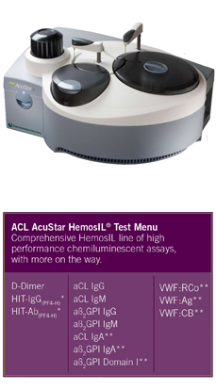
Measurement of VWF collagen binding (VWF:CB) - CLIA
  Werfen IL - ACL AcuStar
Chemiluminescence technology
“Superior range and sensitivity compared to ELISA or immunoturbidimetric assays”
Fully automated
Self-contained, ready-to-use reagent cartridges, stable up to twelve weeks onboard
Assays onboard and available 24 hours/day, 7 days/week
Assay calibration on lot change only
Random access: no batching required
Favaloro EJ, Mohammed S. Laboratory Testing for von Willebrand Factor Collagen Binding (VWF:CB). Methods Mol Biol. 2017;1646:417-433.

Slide 17
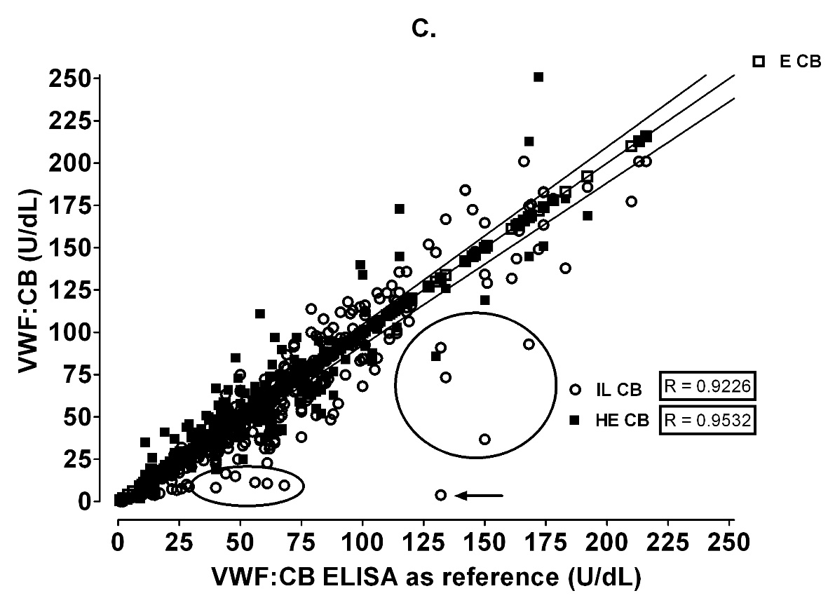
Measurement of VWF collagen binding (VWF:CB)
  Werfen IL - ACL AcuStar
‘VWD data set’; n=314
Good correlation
Some scatter around line of equivalence
Most scatter is likely random noise events (all comparisons)
Some outliers circled/arrowed
Arrowed = random error event (rpt was OK)
Circled = discrepant data – mostly type 2M VWD
Favaloro EJ, Mohammed S. Thromb Res. 2016;141:202-11

Slide 18
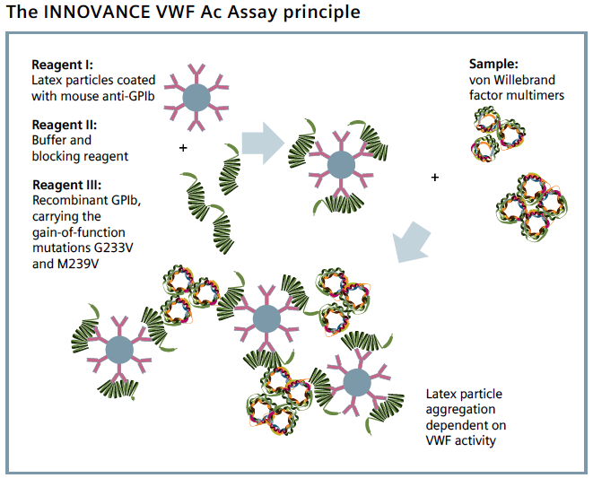
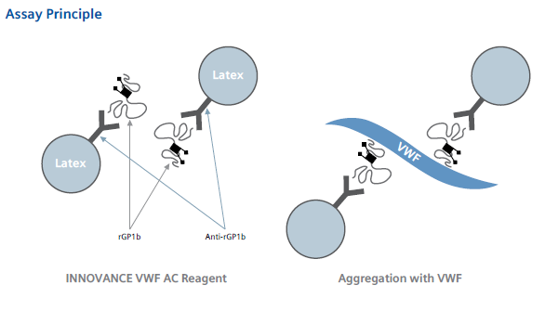
Measurement of VWF GPIb binding – ‘other’
Siemens ‘INNOVANCE’ ‘activity’ assay (VWF Ac; ‘VWF:GPIbM’)
  assay employs recombinant (r) GPIb with 2 gain of function mutations in a latex based GPIb-binding assay
  this rGPIb spontaneously binds native VWF (like PT-VWD GPIb)
  this occurs in absence of ristocetin, so is not a VWF:RCo assay
  however, results of this assay tend to mimic results of VWF:RCo
Patzke J, Favaloro EJ. Laboratory Testing for von Willebrand Factor Activity by Glycoprotein Ib Binding Assays (VWF:GPIb). Methods Mol Biol. 2017;1646:453-460.

Slide 19
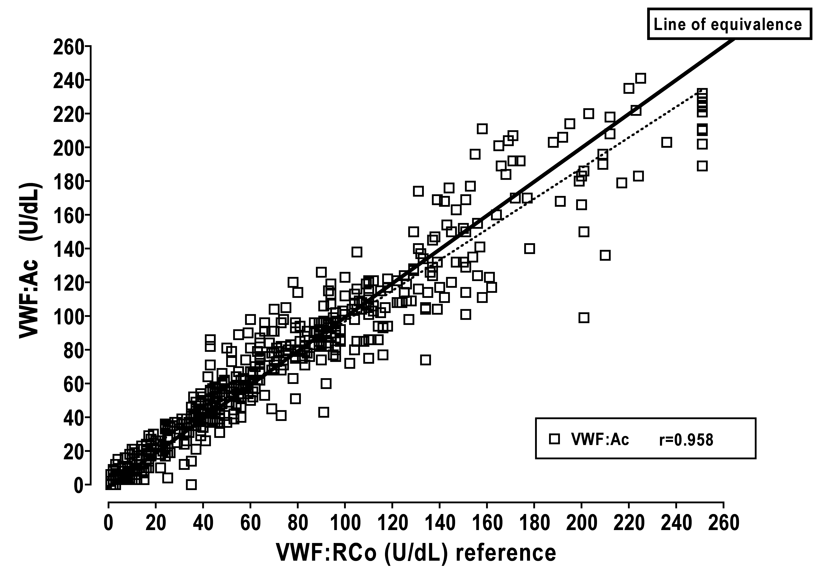
Measurement of VWF GPIb binding – VWF Ac/‘VWF:GPIbM’ cont
600 samples, comprising nearly 100 VWD, nearly 60 individual normal samples, post DDAVP & Biostate, with the rest mostly non-VWD but for VWF/VWD workups.
Favaloro & Mohammed. Thromb Res 2014. 134:1292–1300

Slide 20
Measurement of VWF GPIb binding – ‘other’
RIPA assay (for identification of 2B and PT VWD)
  Ristocetin induced platelet agglutination/aggregation assay
  Also stemmed from the work of Barry Firkin group
  Typically performed by platelet aggregation on an aggregometer
  Different to VWF:RCo
  VWF:RCo = patient plasma + fixed dose of ristocetin (usually ~1mg/ml, but probably higher in the Siemen’s assay) + fixed or lyophilised normal platelets; results compared to standard curve using reference plasma = quantitative value (>50U/dL = ‘normal’)
  RIPA = patient platelet rich plasma + variable dose of ristocetin (typically, ‘normal’ dose = ~1 or 1.2 or 1.5 mg/mL; low dose = <0.7 (usually 0.5) mg/mL; high dose + > 1.5mg/mL).
  Response to low dose = 2B or PT VWD (can be differentiated by RIPA mixing studies or genetic analysis of VWF and/or GPIb)
  Response only to high dose (not to normal or low dose) = VWD (severe 1 or type 2A, 2M).
  No response to any dose = type 3 VWD or BSS
  Response to normal dose but not to low dose – ‘exclude’ severe VWD and 2A, 2B, 2M, PT VWD.
Frontroth JP, Favaloro EJ. Ristocetin-Induced Platelet Aggregation (RIPA) and RIPA Mixing Studies. Methods Mol Biol. 2017;1646:473-494

Slide 21
Measurement of VWF FVIII binding (2N VWD identification)
Extent of color reaction proportional to level of FVIII bound to VWF
Typically performed by ELISA
Patient VWF bound to ELISA plate
Separate ELISA wells with calibration standard & controls
Sandwich process that removes patient VWF bound FVIII, followed by addition of recombinant (r) FVIII, and assay determines the level of patient VWF bound rFVIII
Color reaction
Substrate
HRP
HRP
HRP
Labeled α-FVIII
FVIII
VWF
Mohammed S, Favaloro EJ. Laboratory Testing for von Willebrand Factor: Factor VIII Binding (for 2N VWD). Methods Mol Biol. 2017;1646:461-472.
(Rabbit) α-VWF

Slide 22
Measurement of VWF FVIII binding (2N VWD identification)
Findings compared to those of parallel VWF:Ag assay
Proportion of FVIII bound to VWF (VWF:FVIIIB) compared to amount of VWF bound in VWF:Ag assay
Normal VWF:FVIIIB = >0.7
Values close to 0.5 suggest heterozygous 2N VWD
Values <0.2 suggest homozygous or double heterozygous 2N VWD or heterozygous 2N VWD with a second ‘null’ allele for VWF
Only performed by ~5% of RCPA QAP enrolled VWF test labs
Mohammed S, Favaloro EJ. Laboratory Testing for von Willebrand Factor: Factor VIII Binding (for 2N VWD). Methods Mol Biol. 2017;1646:461-472.

Slide 23
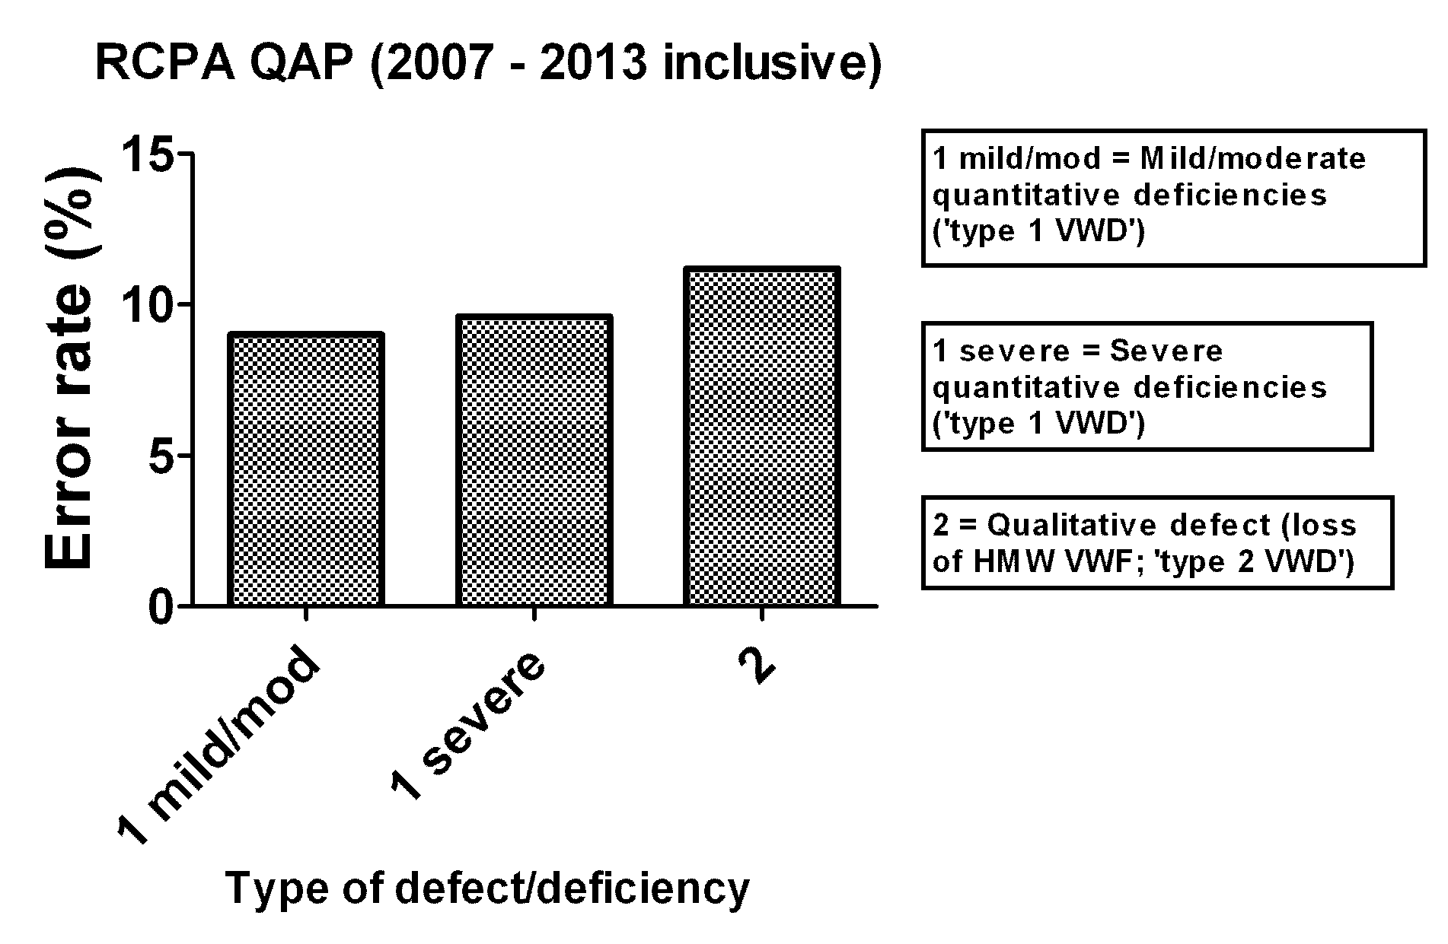
Error rates in VWD ‘laboratory diagnosis’
Favaloro et al. Thromb Res 2014. 134(2):393-403
Favaloro. STH 2014. 40(5):551-70

Slide 24
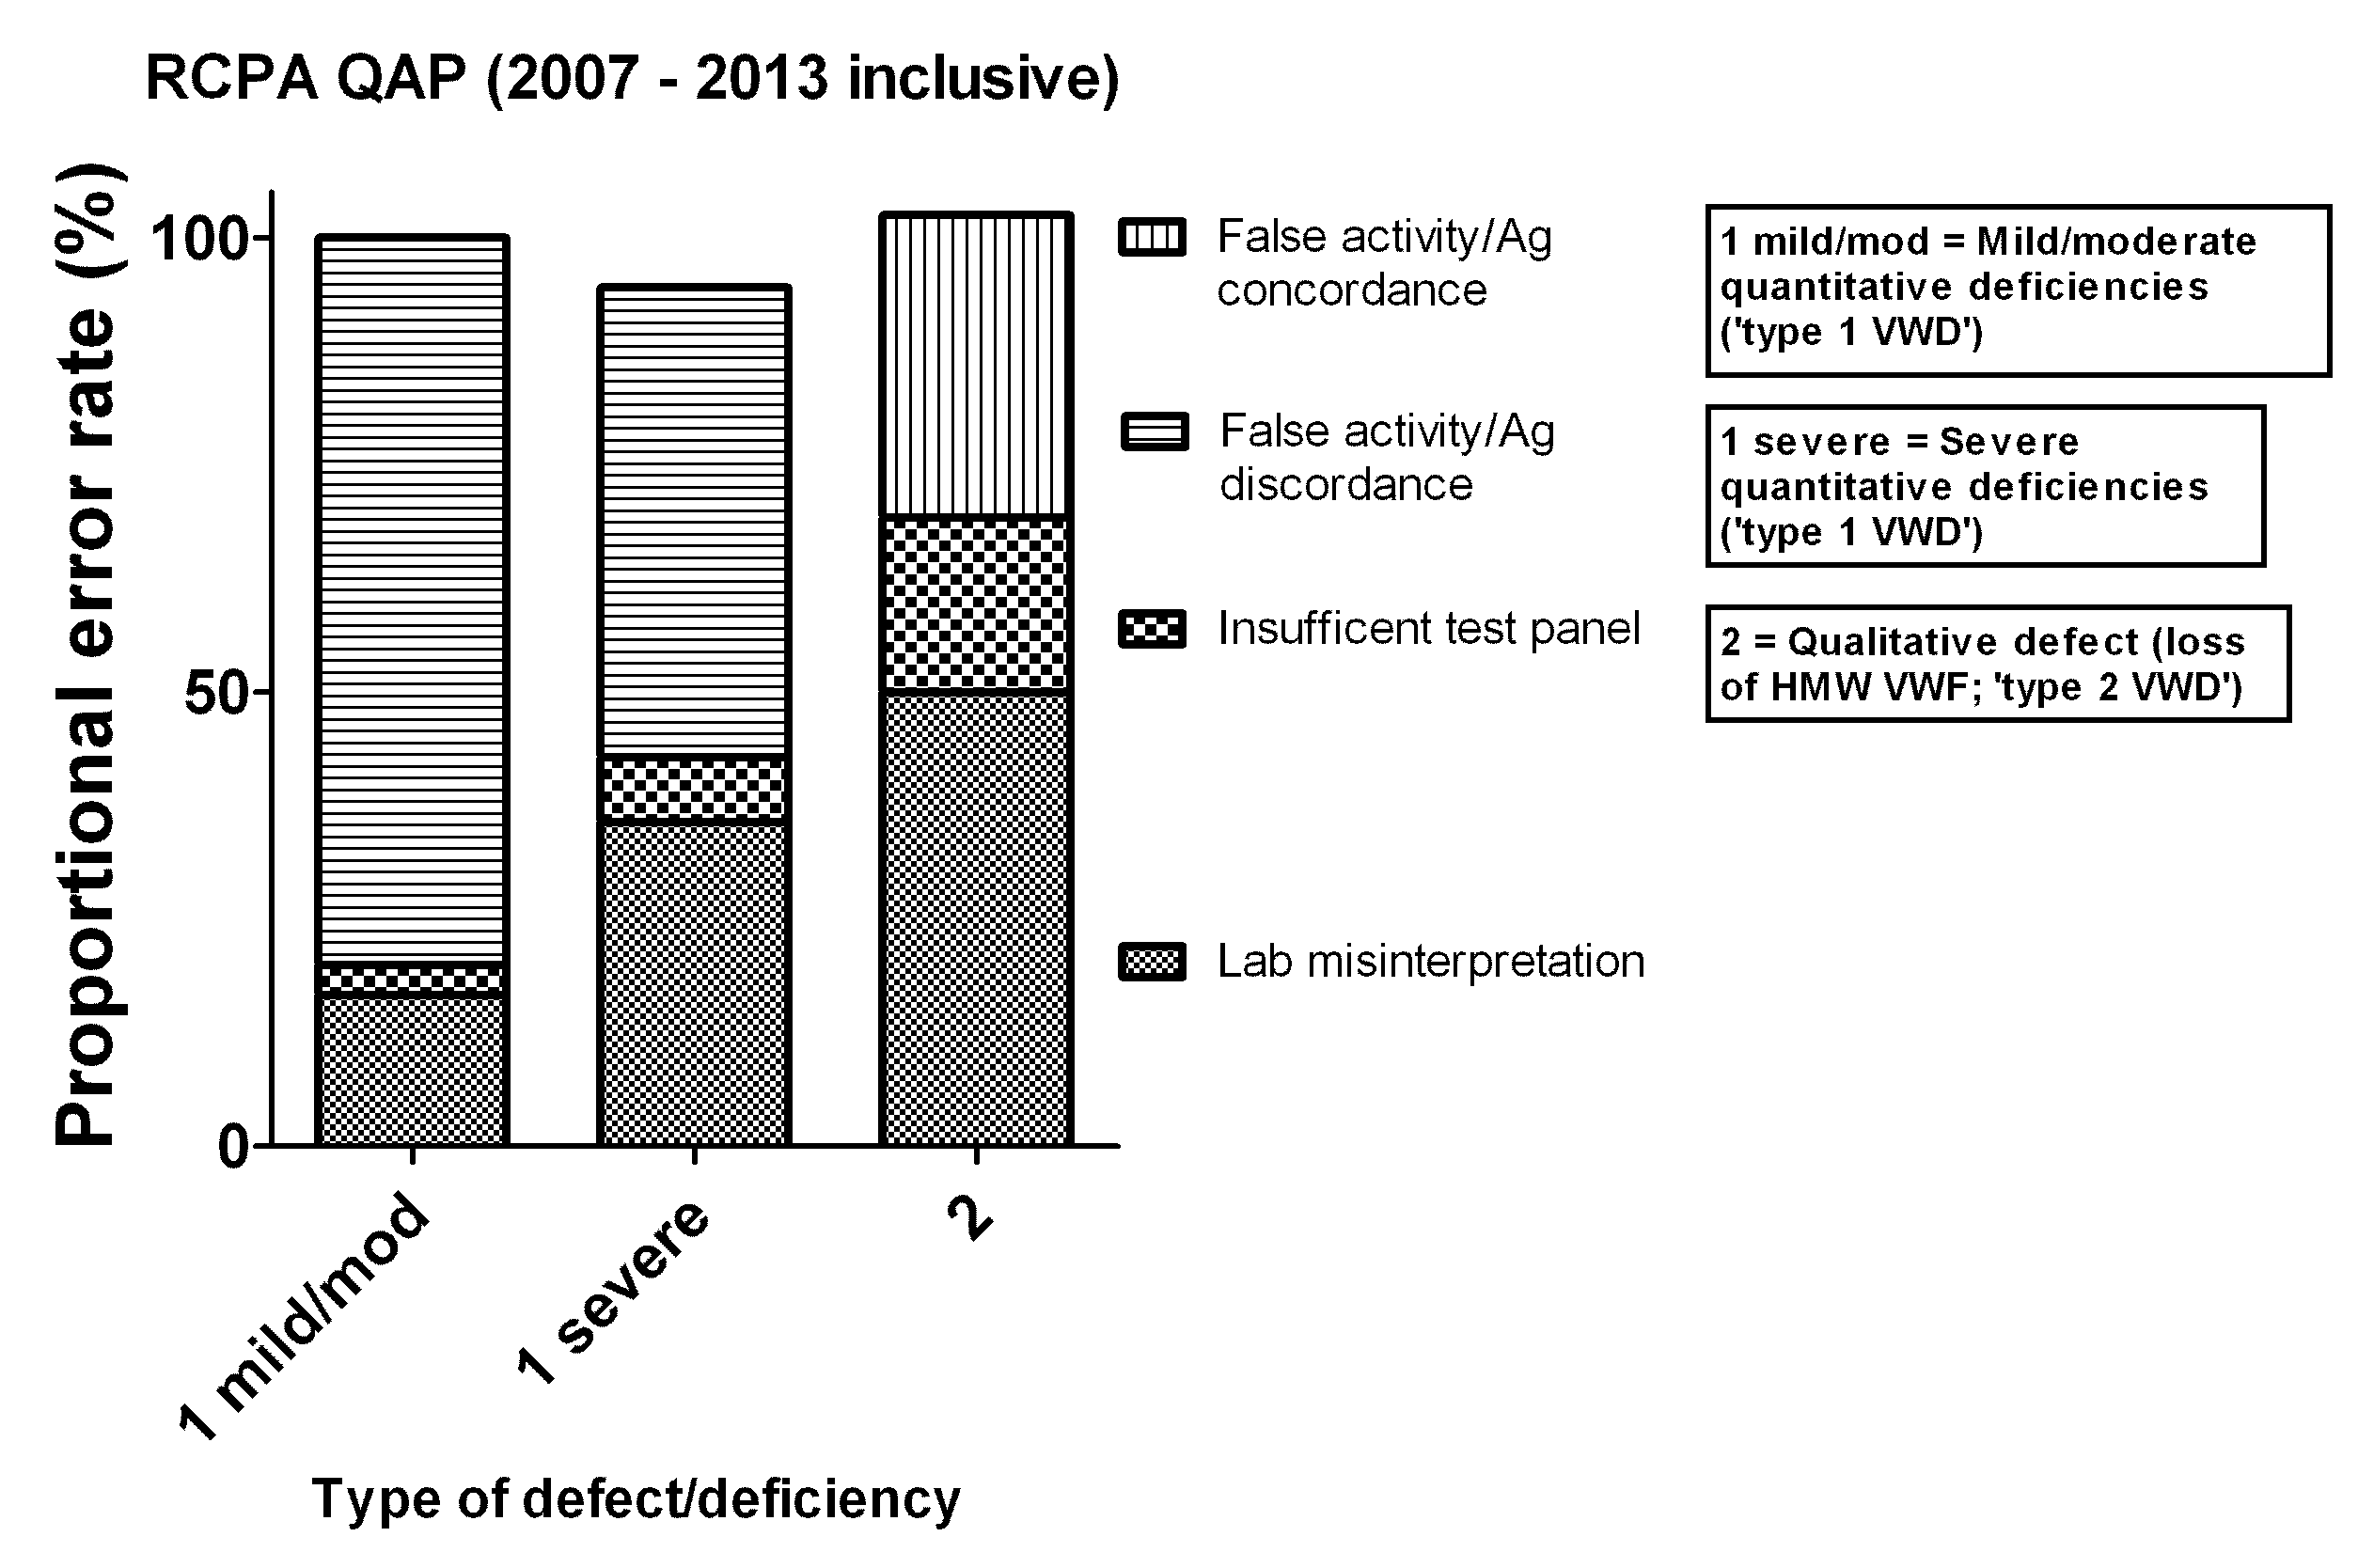
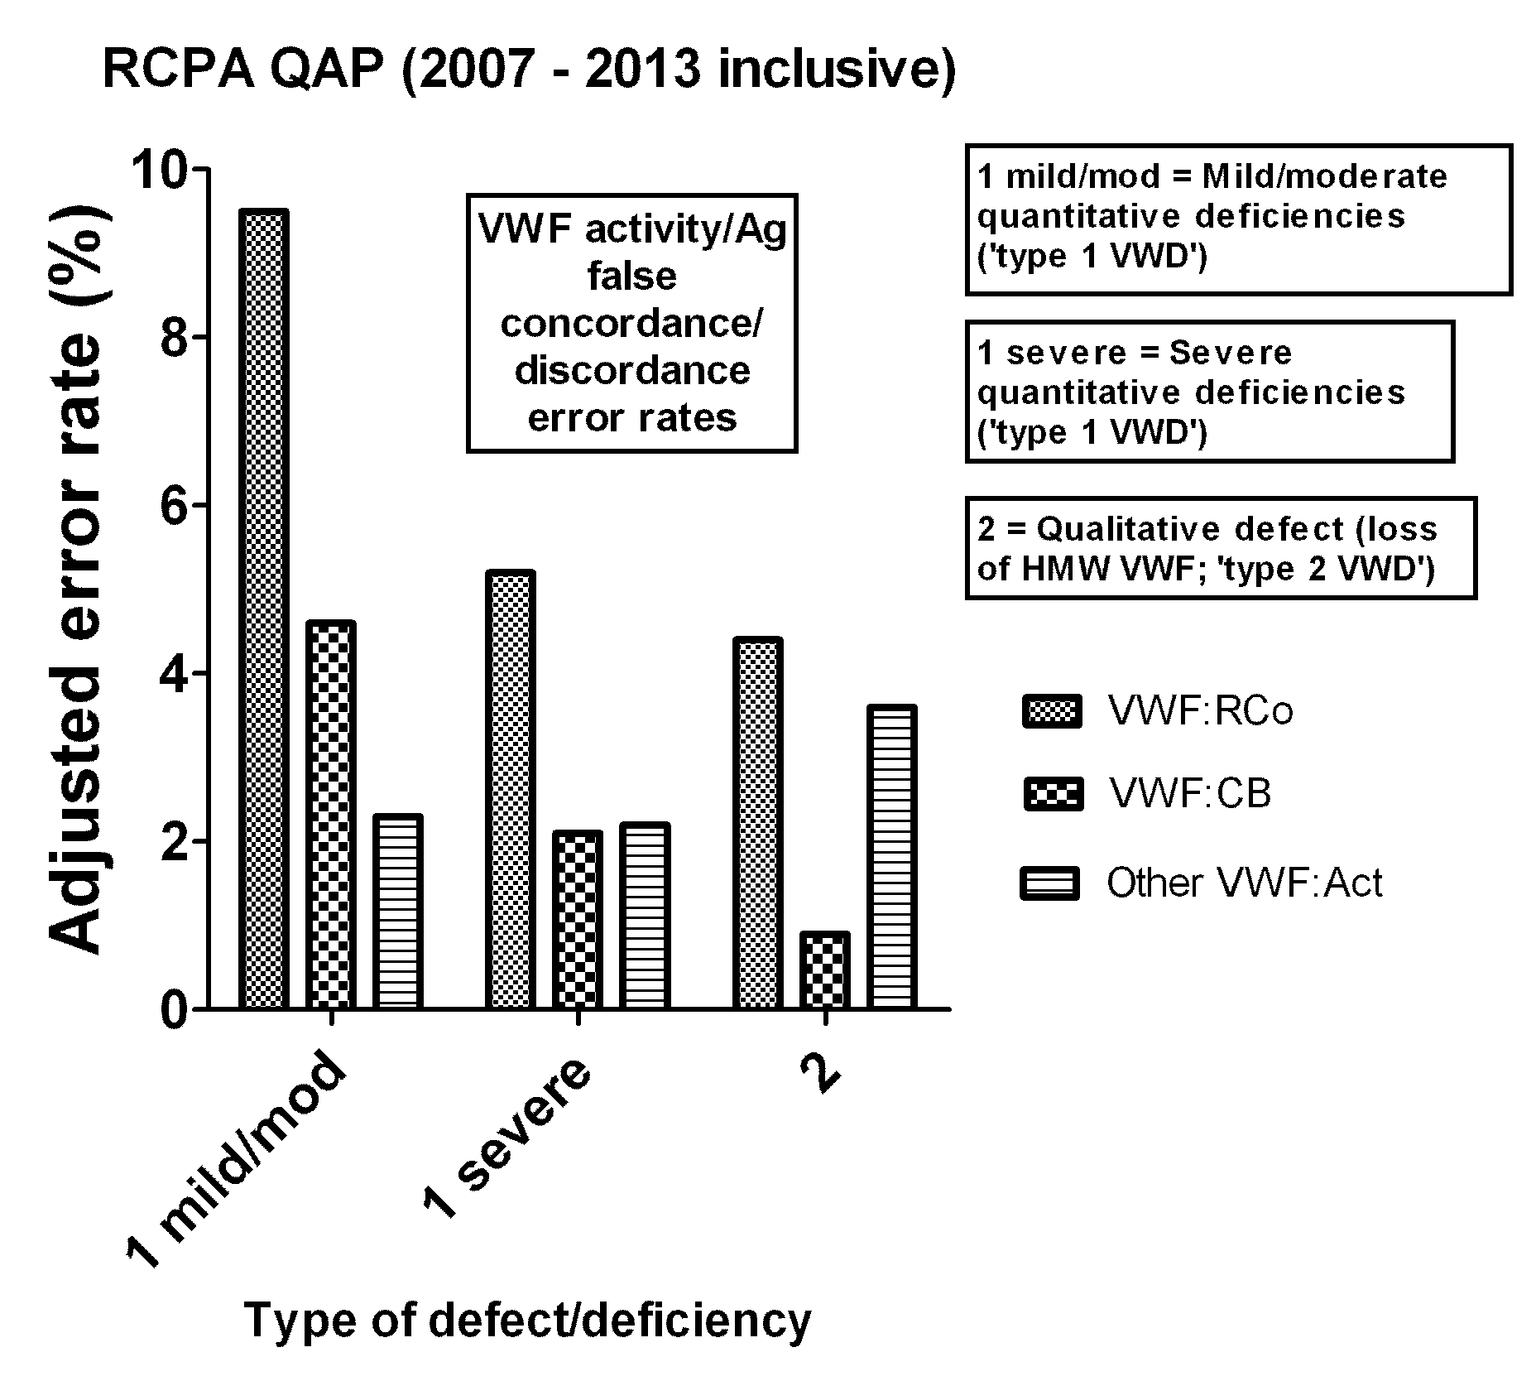
Error rates in VWD ‘laboratory diagnosis’
Favaloro et al. Thromb Res 2014. 134(2):393-403
Favaloro. STH 2014. 40(5):551-70

Slide 25
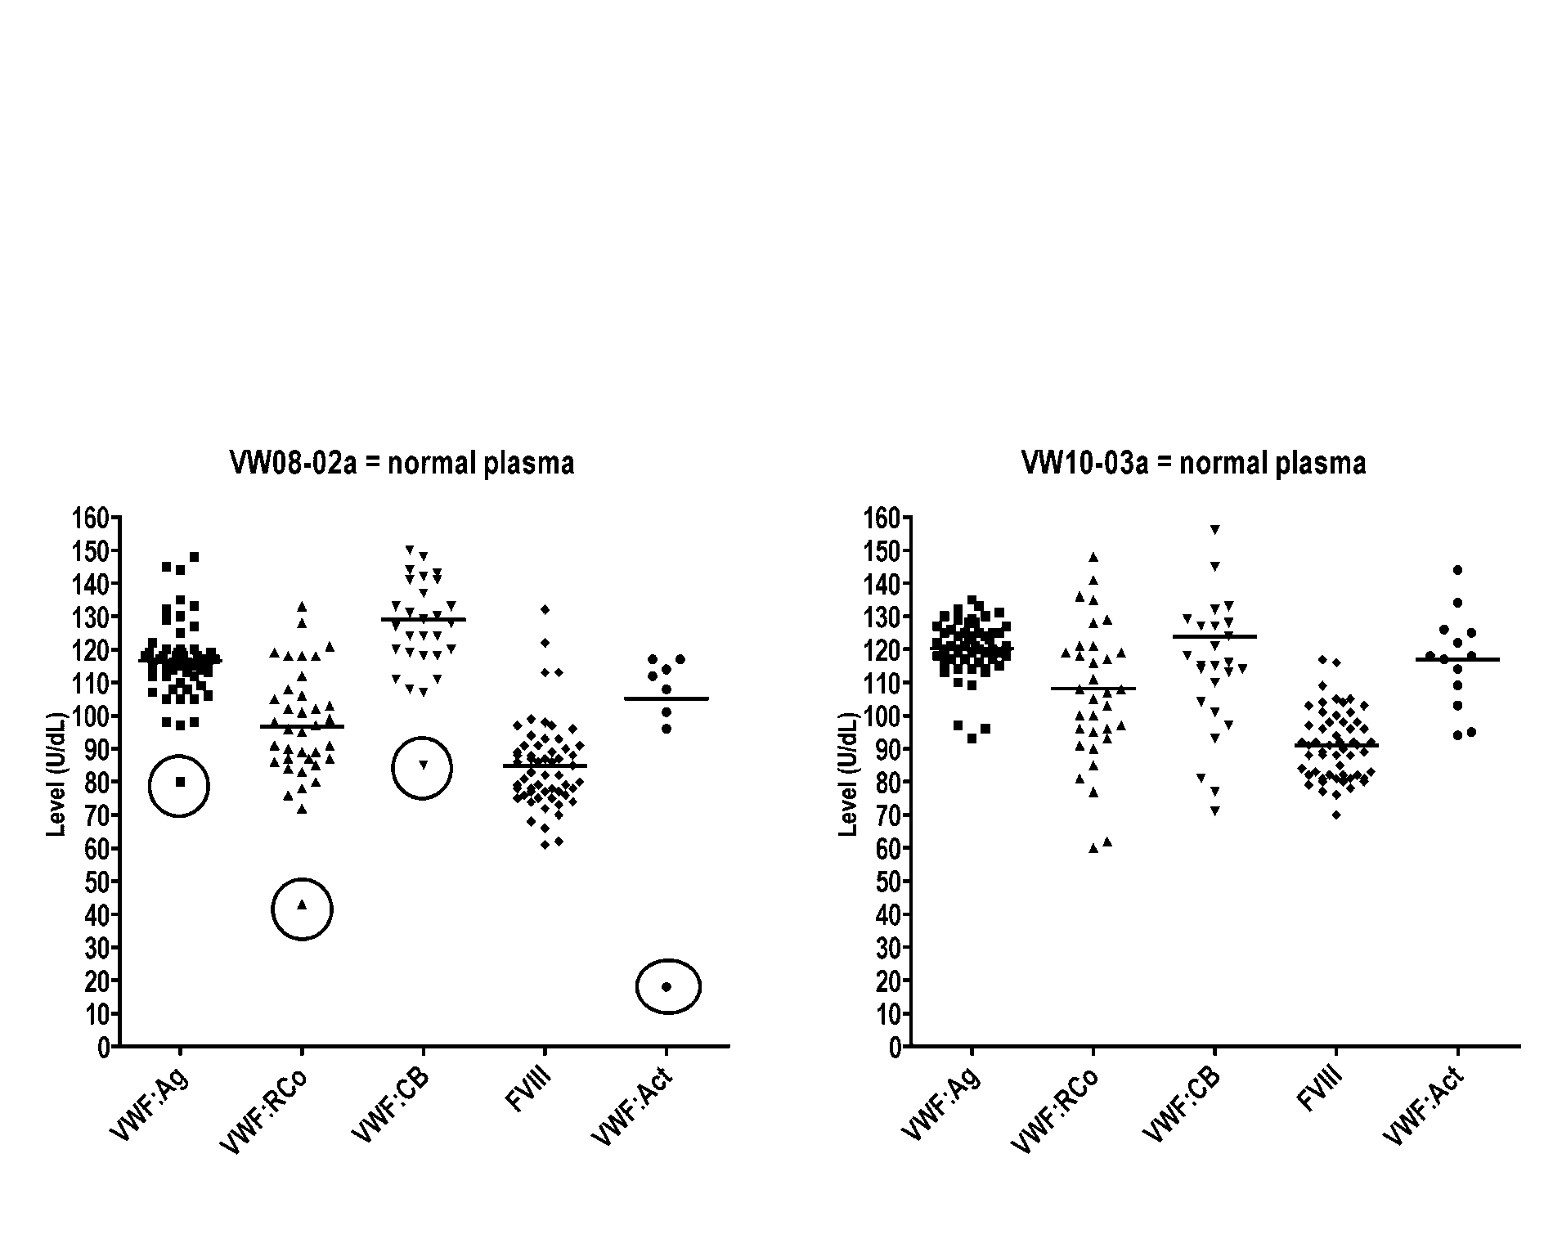
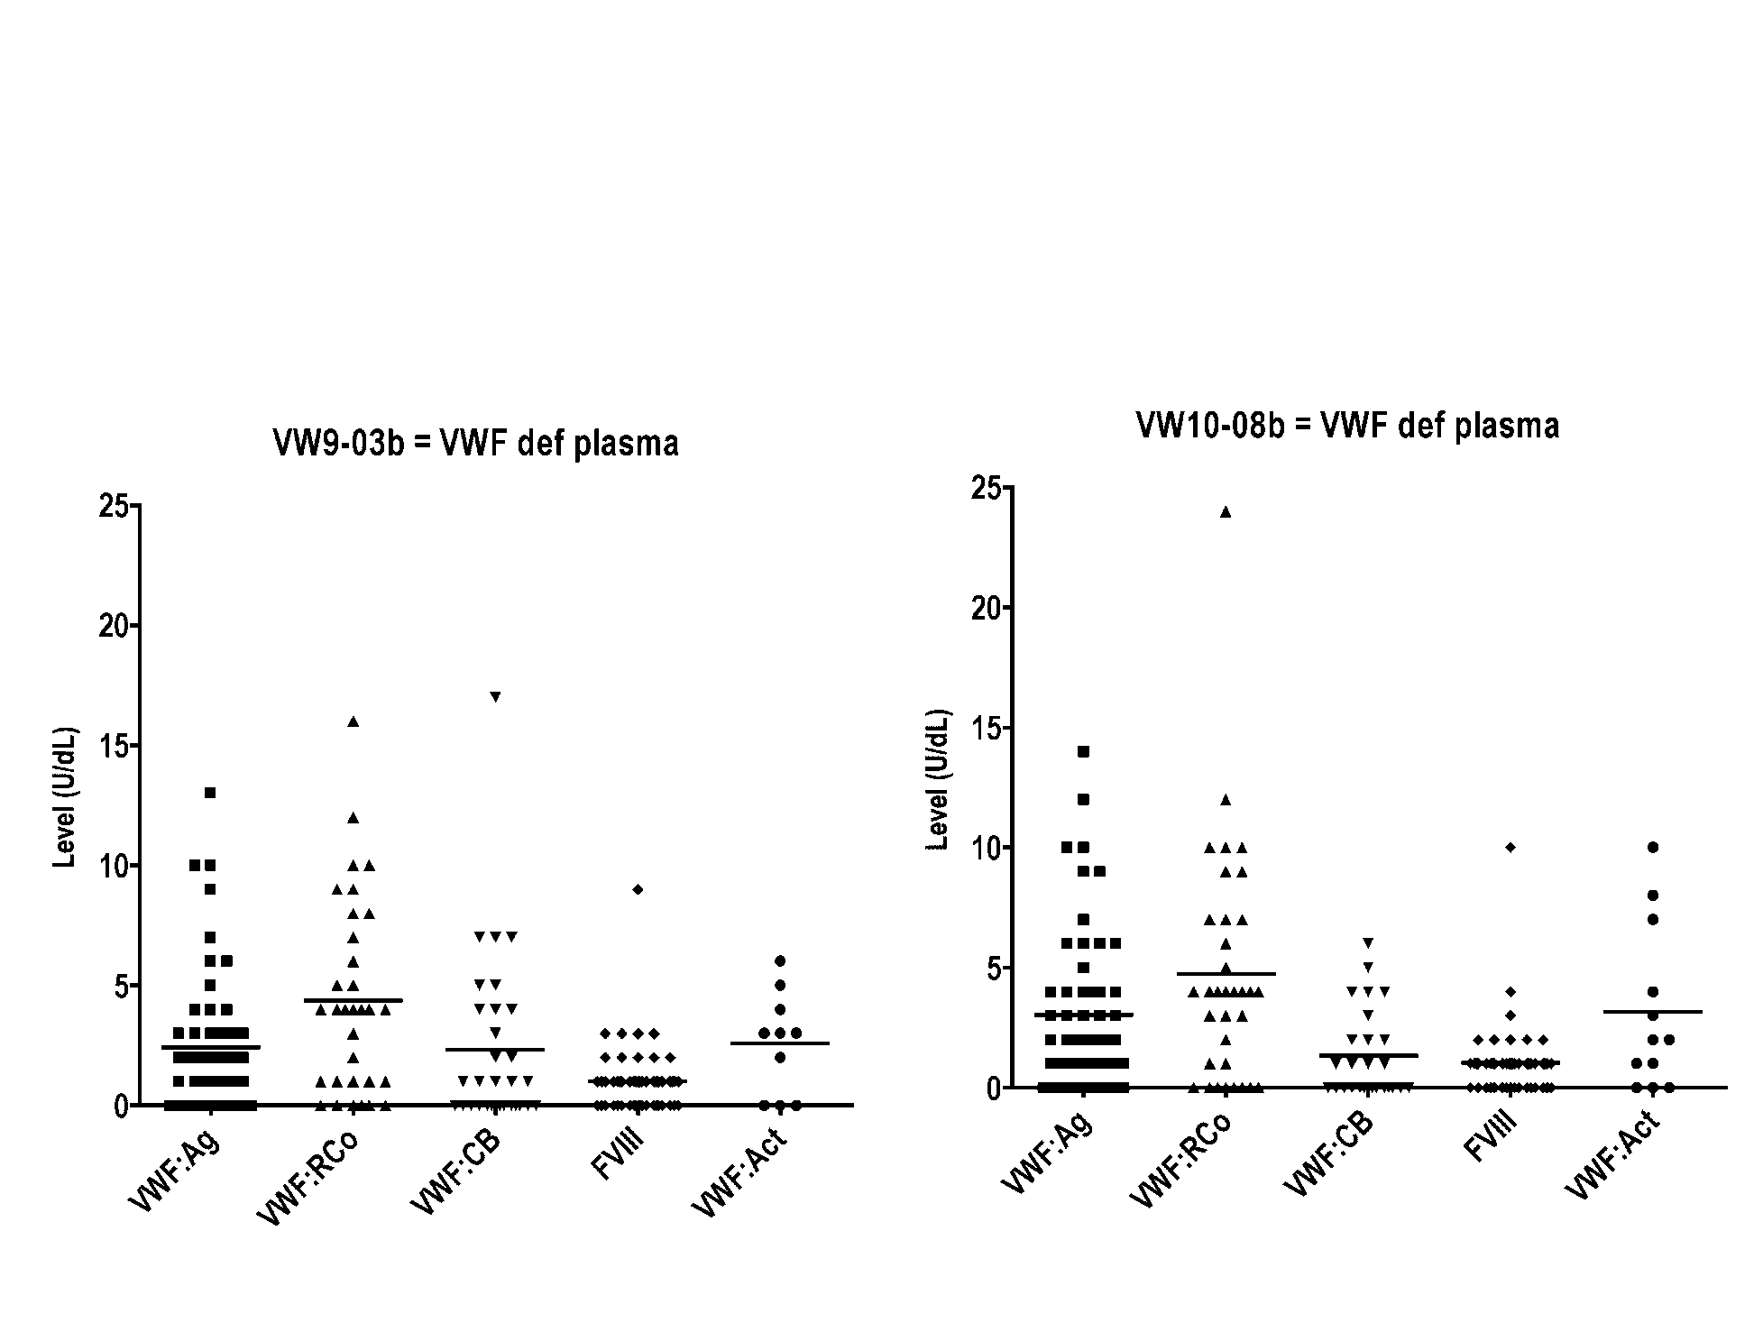
VWF Laboratory assay limitations
Assay variability
Lower limit assay sensitivity
Favaloro et al. Thromb Res 2014;134:393-403
Favaloro et al. Clin Lab Sci 2008;21:178-185

Slide 26
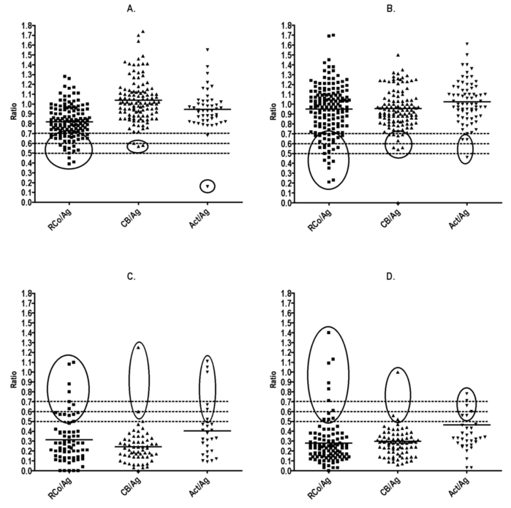
VWF Laboratory assay limitations
Discrimination of type 1 vs 2 VWD (RCPAQAP)
VWF deficient samples (‘type 1 VWD’)
Normal
samples
HMW VWF deficient samples (‘type 2A VWD’)
HMW VWF deficient samples (type 2B VWD)
Favaloro et al. Thromb Res 2014;134:393-403

Slide 27
What about VWF Multimer analysis?
High Molecular
All multimers present = normal (i.e., not VWD), or 2N VWD or 2M VWD
All multimers present but in lower intensity = type 1 VWD (or maybe specimen artefact)
Loss of HMW VWF = possible 2A or 2B/PT VWD (or maybe specimen artefact)
Loss of HMW & IMW VWF = probable 2A (or maybe specimen artefact)
Weight VWF
Intermediate
Molecular
Weight VWF
Low Molecular
Weight VWF
Type
Type
Mild
2B
2A
Type 1
Normal
Normal
Normal

Slide 28
Multimer analysis – the good, bad & the ugly
Multimer analysis is laborious and requires a high level of technical skill
Performing multimers on 6-12x samples may take several weeks of technical time.
Automated testing can perform ~36x samples for VWF:Ag, VWF:RCo, VWF:CB and FVIII:C in a single day
<5% of VWF test labs perform multimer testing (2/56 labs in RCPA QAP) in Australasia
Perhaps 15-25% of labs perform multimer testing in Europe/North America
NASCOLA survey (Chandler WL, et al. Am J Clin Pathol. 2011;135:862-869):
  15% overall average error rate,
  5% of labs reported loss of HMW VWF in normal samples,
  18% reported loss of HMW VWF in type 1 VWD samples,
  18% reported a normal multimer pattern in type 2 VWD.
ECAT survey (Meijer & Haverkate.Semin Thromb Hemost. 2006;32:485-491):
  23% error rate for normal samples
  up to 52% error rate in type 1 VWD

Slide 29
What about VWF Multimer analysis?
High Molecular
low VWF but concordant activity & antigen (i.e. RCo/Ag & CB/Ag > 0.7 = type 1 VWD or ‘low VWF’)
discordant activity & antigen x2 (i.e. RCo/Ag & CB/Ag < 0.5 = probable loss of HMW VWF = type 2A or 2B VWD)
discordant activity & antigen x1 (i.e. RCo/Ag or CB/Ag < 0.5 = probable VWF ‘dysfunction’ = type 2M VWD)
Weight VWF
VWF:
VWF:
CB
RCo
Intermediate
VWF:
Molecular
Ag
Weight VWF
Assay inter-relationships
Low Molecular
Weight VWF
Type
Type
Mild
2B
2A
Type 1
Favaloro EJ, Sem Thromb Hemost, 2007; 33: 727-44
Normal
Normal
Normal

Slide 30
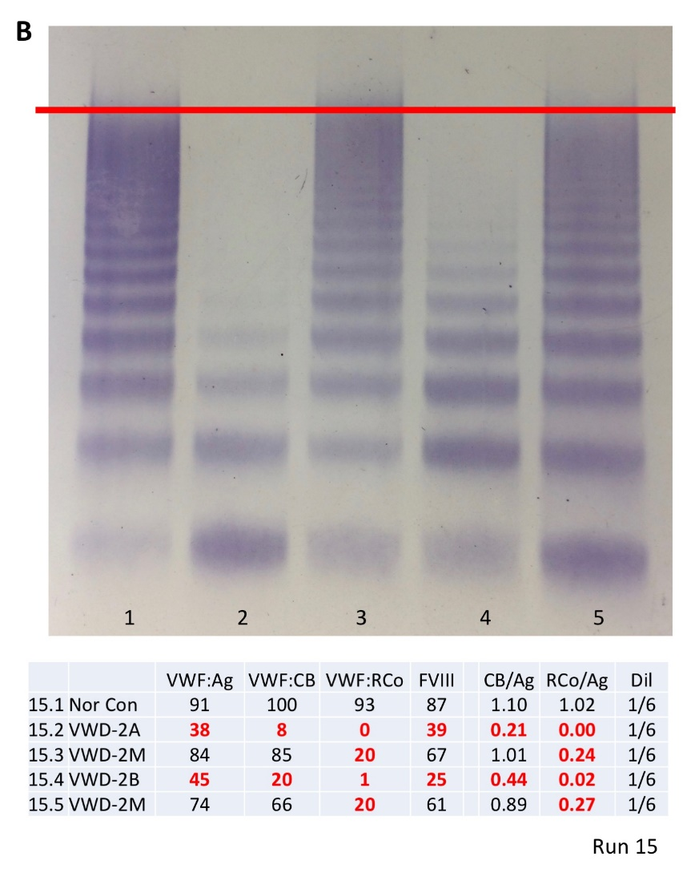
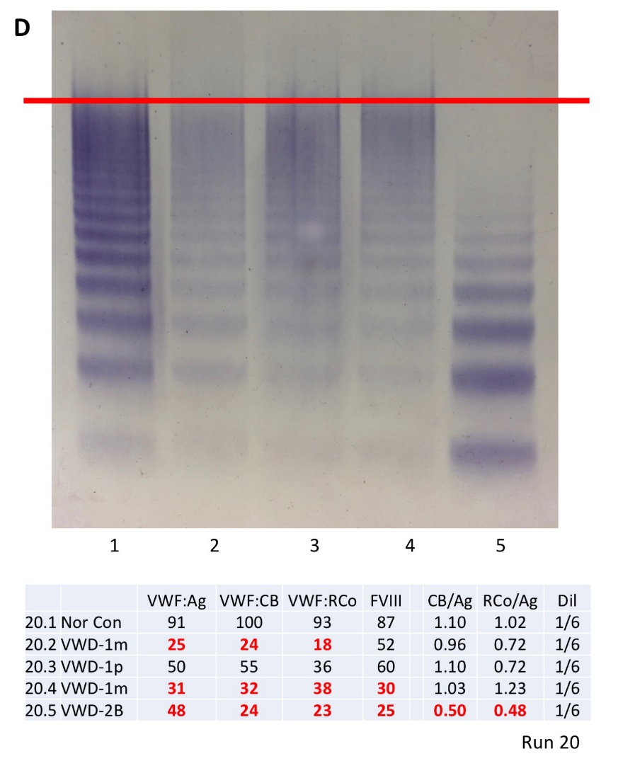
What about VWF Multimer analysis?
recent ‘revalidation’ of expected test patterns and multimer analysis with a semi-automated VWF multimer test system
low VWF but concordant activity & antigen (i.e. RCo/Ag & CB/Ag > 0.7 = type 1 VWD or ‘low VWF’)
discordant activity & antigen x2 (i.e. RCo/Ag & CB/Ag < 0.5 = probable loss of HMW VWF = type 2A or 2B VWD)
discordant activity & antigen x1 (i.e. RCo/Ag or CB/Ag < 0.5 = probable VWF ‘dysfunction’ = type 2M VWD)
Favaloro EJ, Oliver S. Haemophilia. 2017;23:e373-e377.
Oliver S, et al. Methods Mol Biol. 2017;1646:495-511.

Slide 31
Laboratory ‘Diagnosis’ of VWD
Lupus anticoagulant guidelines:
  Assess by at least two assays using different principles
  Can exclude LA if both negative
  Can identify LA if either is positive
VWD can be caused by mutations anywhere on VWF
Type 2 VWD will only be properly identified if labs perform activity testing using assays employing as many principles as possible
At the very least, explore GPIb binding (VWF:RCo [or VWF:GPIbR] and/or VWF Ac [VWF:GPIbM]) plus collagen binding (VWF:CB), in addition to VWF:Ag and FVIII
Laffan et al. The diagnosis and management of von Willebrand disease: a United Kingdom Haemophilia Centre Doctors Organization guideline approved by the British Committee for Standards in Haematology. Br J Haematol 2014; 167: 453–65.

Slide 32
Laboratory ‘Diagnosis’ of VWD – a summary
Type 1 – low VWF, but all VWF assays similar (i.e., ratios ~1 (>0.7)); VWF:Ag, VWF:CB, VWF:RCo.
Type 3 – ‘undetectable’ VWF (LOD issues); VWF <5U/dL (VWF:Ag [VWF:CB, VWF:RCo)]).
Type 2A – usually low VWF:Ag, but disproportionally lower VWF:CB & VWF:RCo (both activity/Ag ratios <0.7)
Type 2B – low dose RIPA; disproportionally lower VWF:CB & VWF:RCo than VWF:Ag (both activity/Ag ratios <0.7)
Type 2N – VWF:FVIIIB (FVIIIB/VWF:Ag <0.7) [low FVIII:C/VWF:Ag]
Type 2M – low VWF ‘activity’/Ag ratio

Slide 33
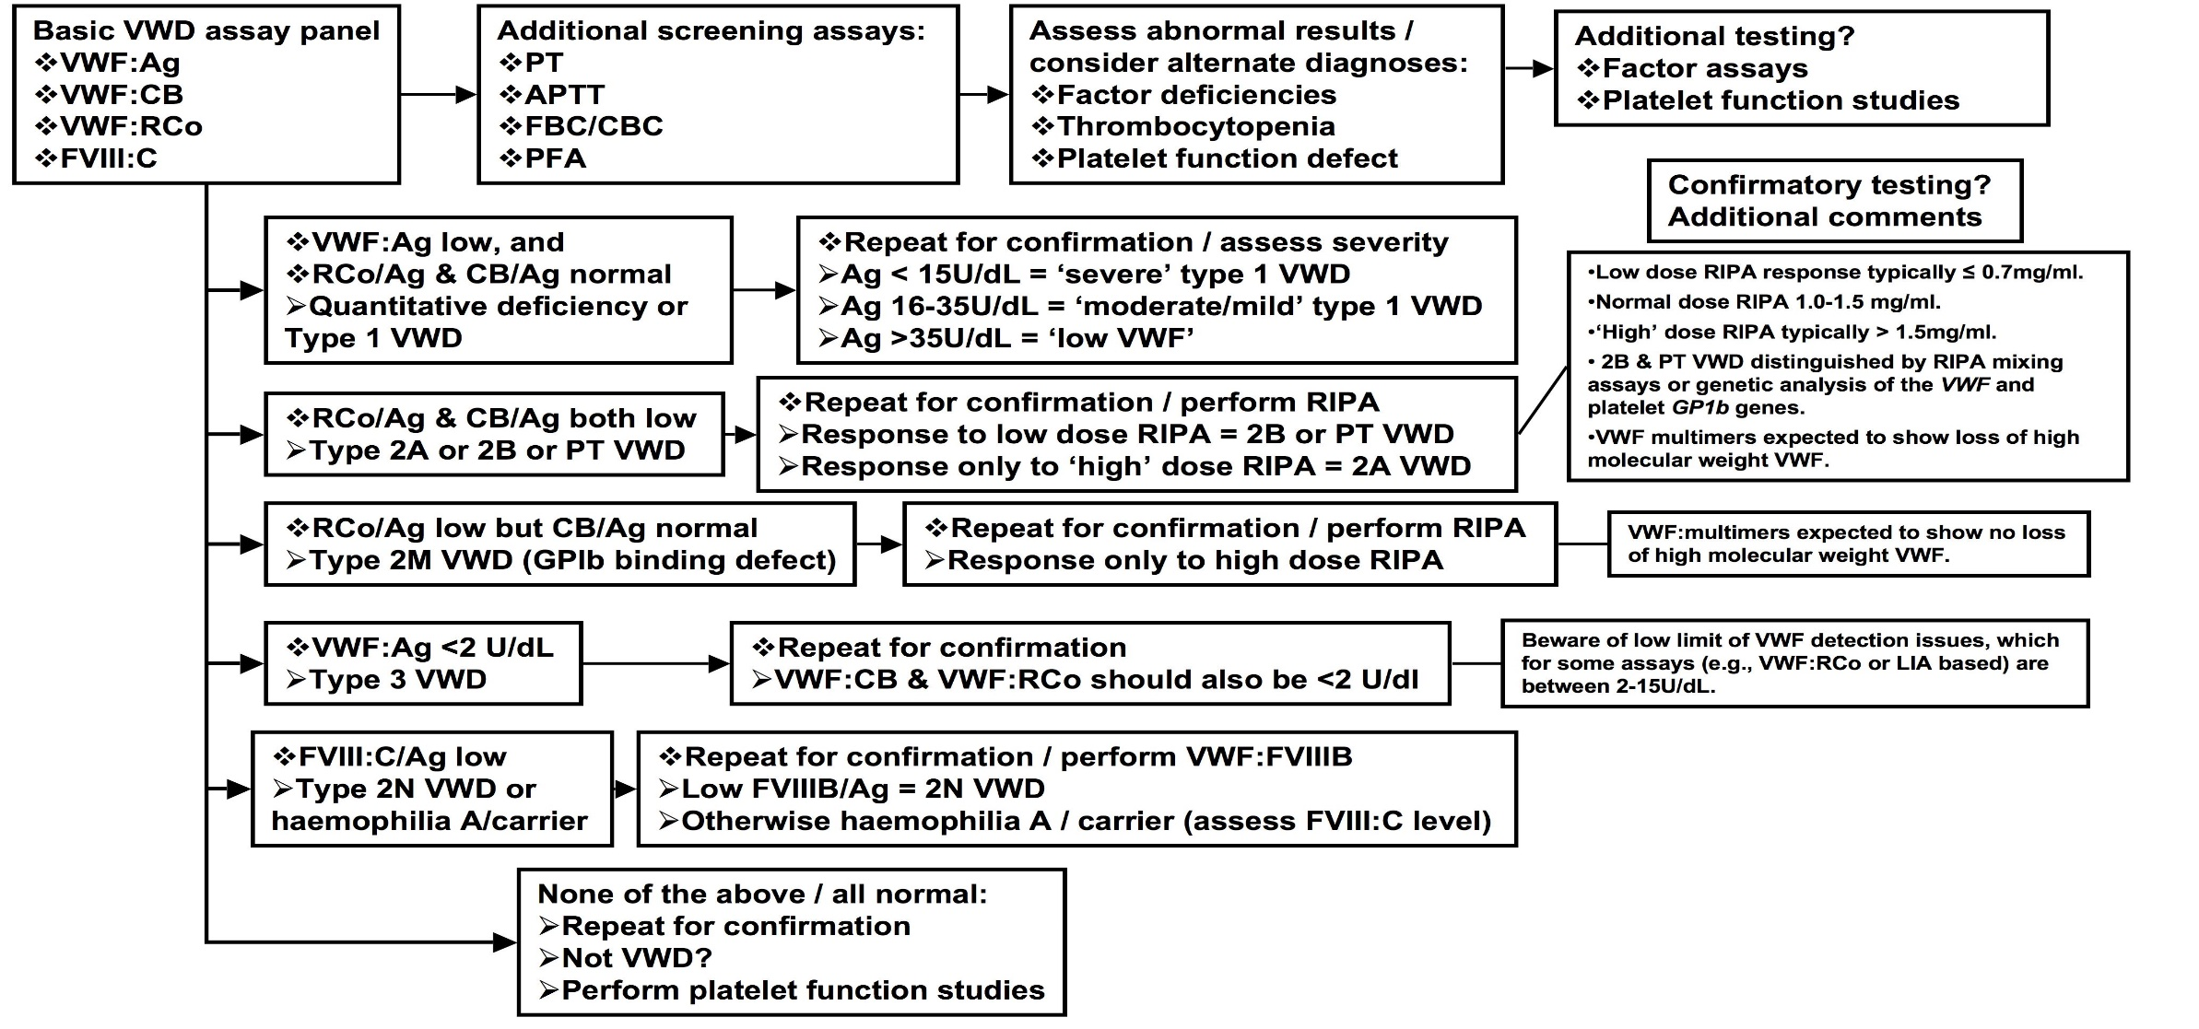
VWD lab diagnosis – an algorithmic approach

Slide 34
Acknowledgments
Meeting organisers, especially Joanne Josephs
Westmead clinical colleagues, especially Leonardo Pasalic & Jennifer Curnow
RCPAQAP Haematology, especially Roslyn Bonar
Current/recent past diagnostic Haemostasis laboratory staff
  Soma Mohammed
  Jane McDonald
  Ella Grzechnik
  Monica Ahuja
  Shabana Azimulla
  Yifang Zhang
Haemostasis = Love
Everybody talks about it, nobody understands it.

